Slide 1
INT301 Open-source Technologies
Navlesh kumar singh
11903852
Roll No. 09

Slide 2
Using any Open Source Software transfer the files from server to client.

Slide 3
FileZilla
FileZilla is a free, open-source FTP (File Transfer Protocol) client software that allows users to upload and download files from FTP servers. It is available for Windows, macOS, and Linux operating systems.
FileZilla supports FTP, SFTP (SSH File Transfer Protocol) and provides a user-friendly graphical interface for easy file management. It also supports drag and drop functionality, bookmarks, and remote file editing. Additionally, FileZilla includes features such as site manager, speed limits, and remote file search. FileZilla is a popular and reliable FTP client that is widely used by both beginners and advanced users.

Slide 4
Scope of this software
The main purpose of FileZilla software is to provide a convenient and easy-to-use FTP client for users to transfer files between their local computer and remote servers. FTP is a commonly used protocol for transferring files over the internet and is often used by web developers and designers to upload their websites and files to web servers. With FileZilla, users can upload and download files from FTP servers, as well as manage their files remotely.

Slide 5
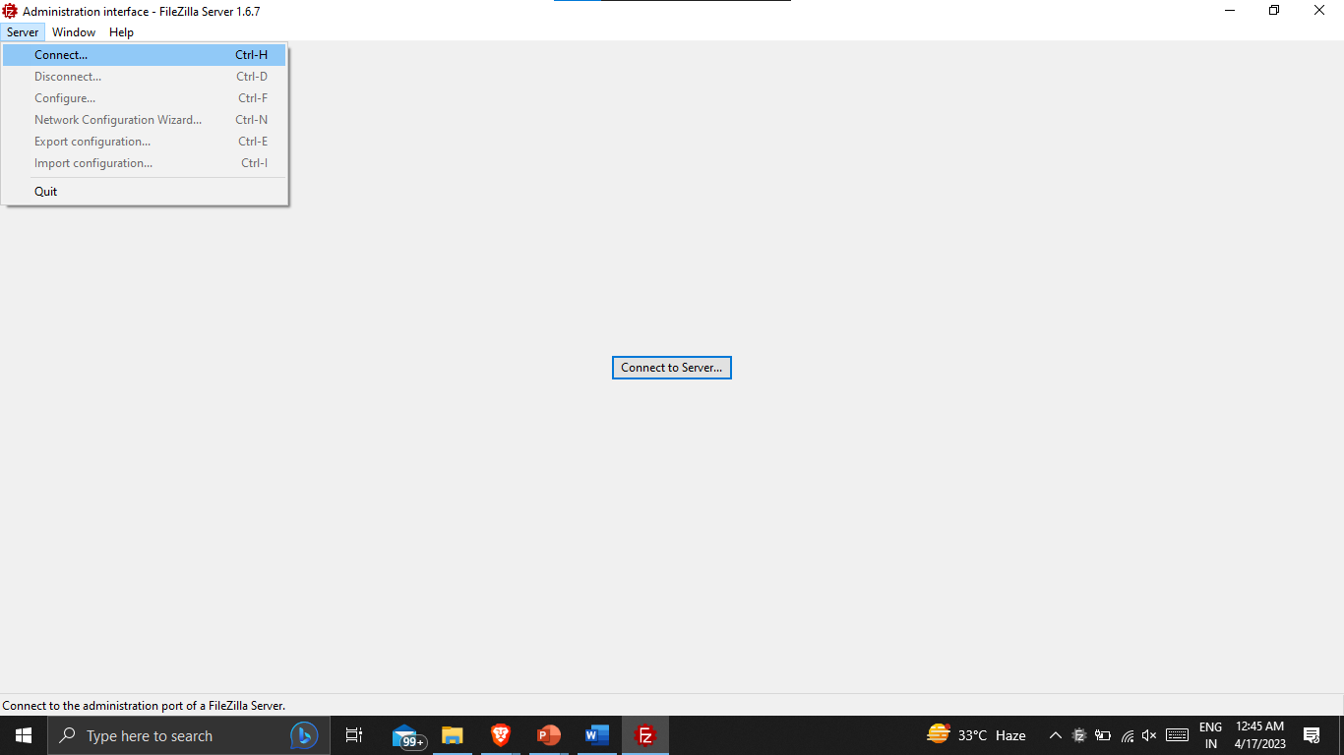
How to use ?
Download and install Filezilla server and application on your system. It is available for Windows, Mac, and Linux operating systems.
Launch Filezilla sever and configure details.

Slide 6
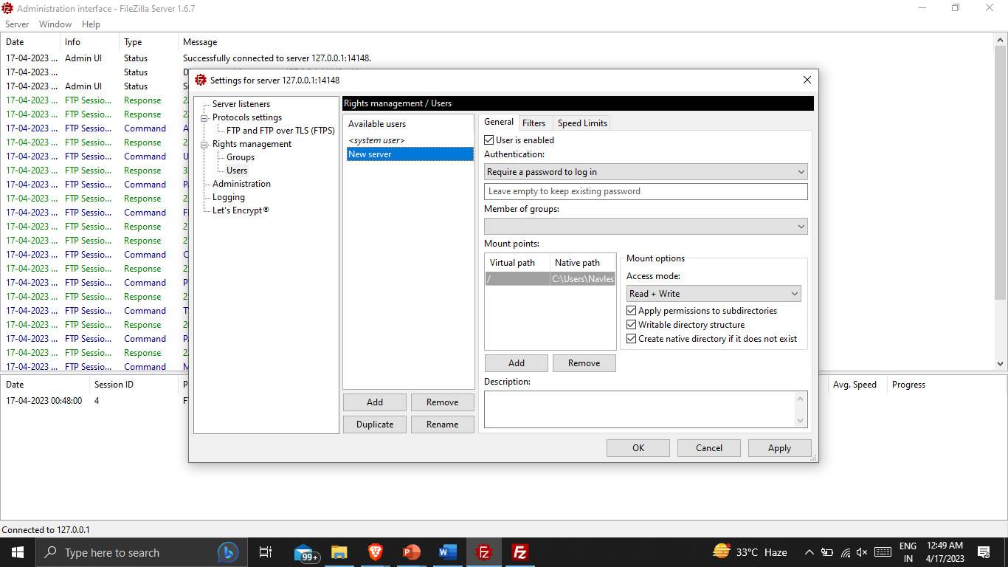
Cofigure server details and add user, its authentication details, virtual path of server and its access permission is added.

Slide 7
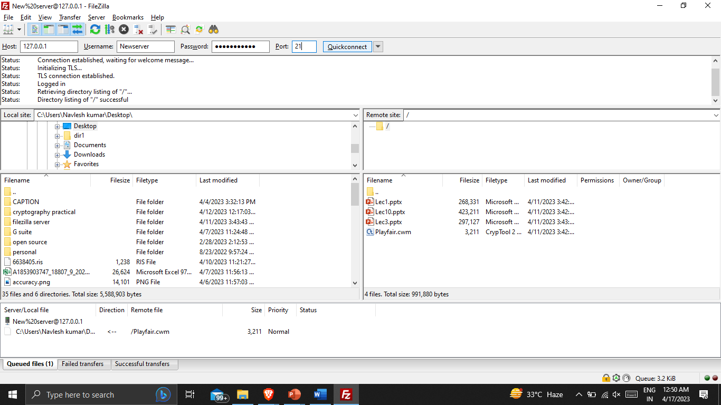
Enter the details of host address, username and password of server. Files can be transfered from server to local and vice versa.

Slide 8
Conclusion
FileZilla software provides convenient and easy-to-use FTP client for users to transfer files between their local computer and remote servers.
Filezilla can help in managing the content of websites, storing backup files and storing personal files for remote access.
FileZilla is a versatile and feature-rich FTP client that offers a range of capabilities such as drag-and-drop functionality, site manager, Transfer queue and File editing make it a popular choice for transferring files securely over the internet.

Slide 9
THANK YOU

